Slide 1
A Presentation on Final Project
Presented By
Vakul Reddy Pannala

Slide 2
Project Description
In recent times cyber attacks are happing almost on a daily basis In the case of making the overall network more secure, identifying all the vulnerabilities is a crucial part for organizations.
There are various information such as vulnerabilities of each device, network protocol types, port numbers, and so on can be extracted by performing data analysis.
In the data visualization process, all the vulnerabilities can be shown in the graphical representation and this process can also be very beneficial in the case of showing new insights and small details of the dataset as well.

Slide 3
Objective
To perform data analysis in the case of identifying the vulnerabilities in the system
To implement a Common Vulnerability Scoring System for understanding the vulnerability level of each instance
To implement three machine learning algorithms that can able to extract the vulnerability of the instance in the dataset to predict the CVSS score Aaccurately.

Slide 4
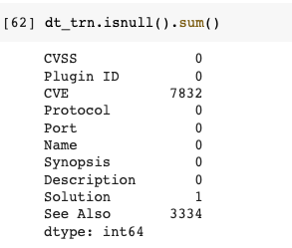
Steps
Data Analysis
Preprocessing
Model development
Result Analysis
Data Analysis:
Here we can see the number of null values present in the each column.

Slide 5
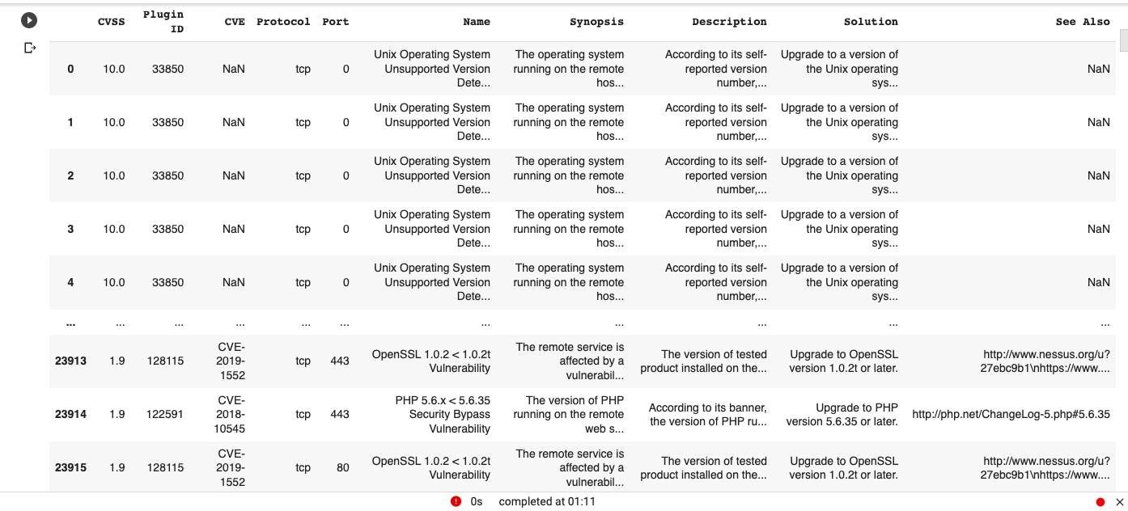
Data Preprocessing

Slide 6
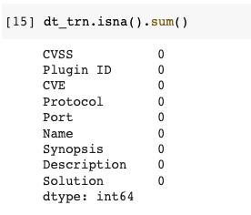
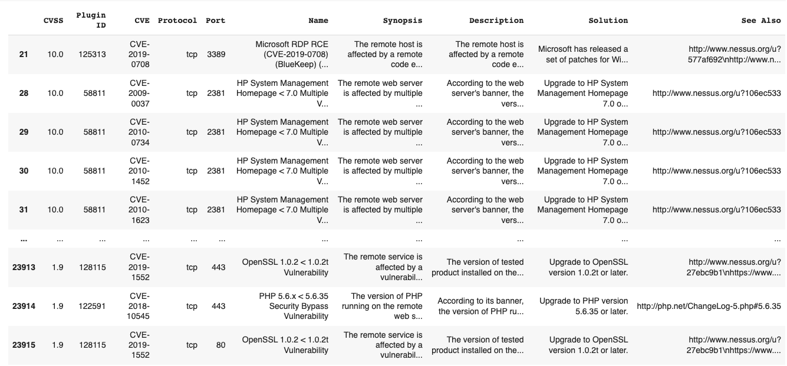
Data Preprocessing
Dropping the rows with the null values in the dataset.

Slide 7
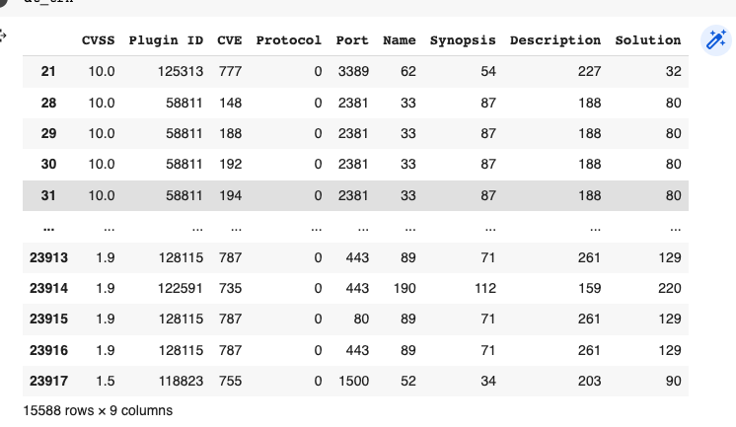
Convert all the columns to catgorical values.

Slide 8
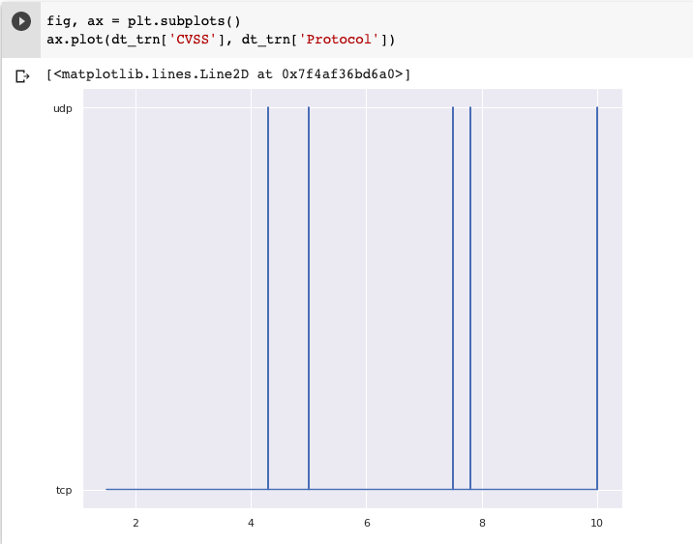
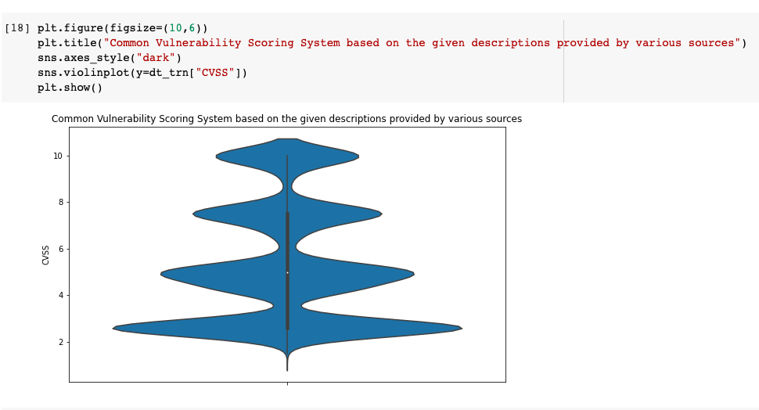
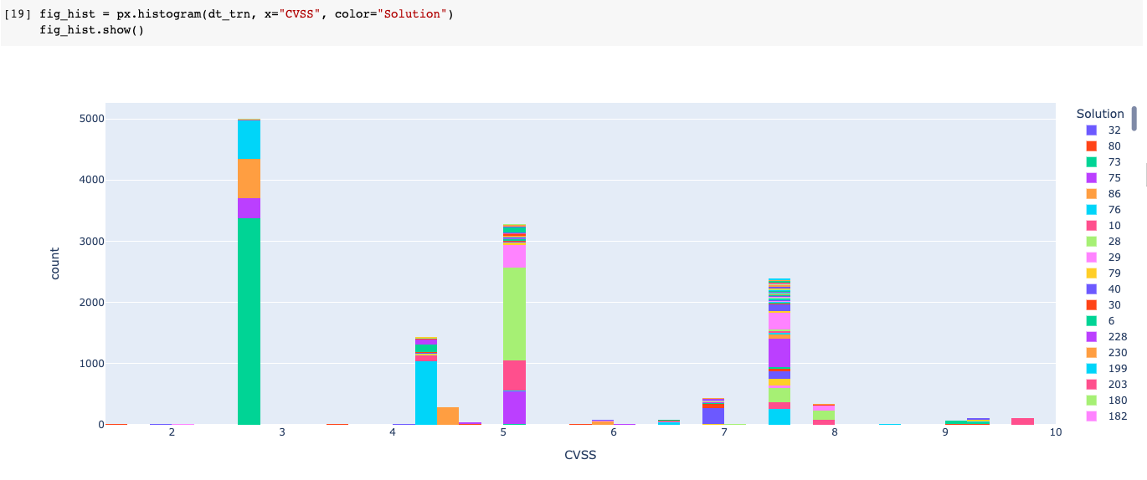
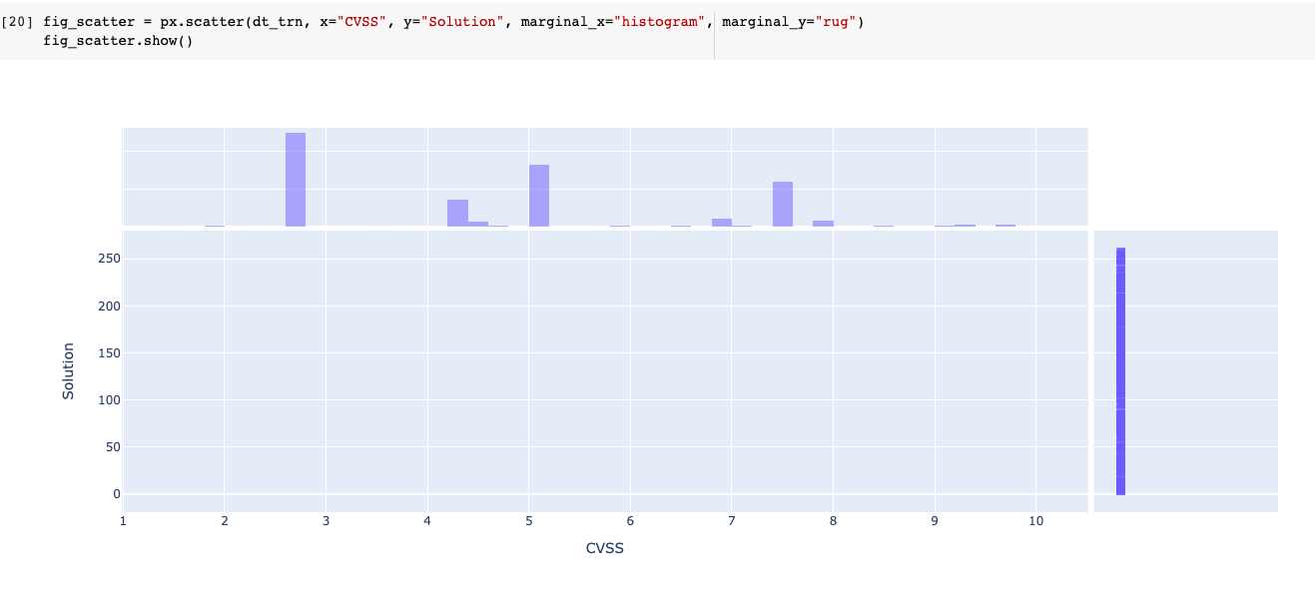
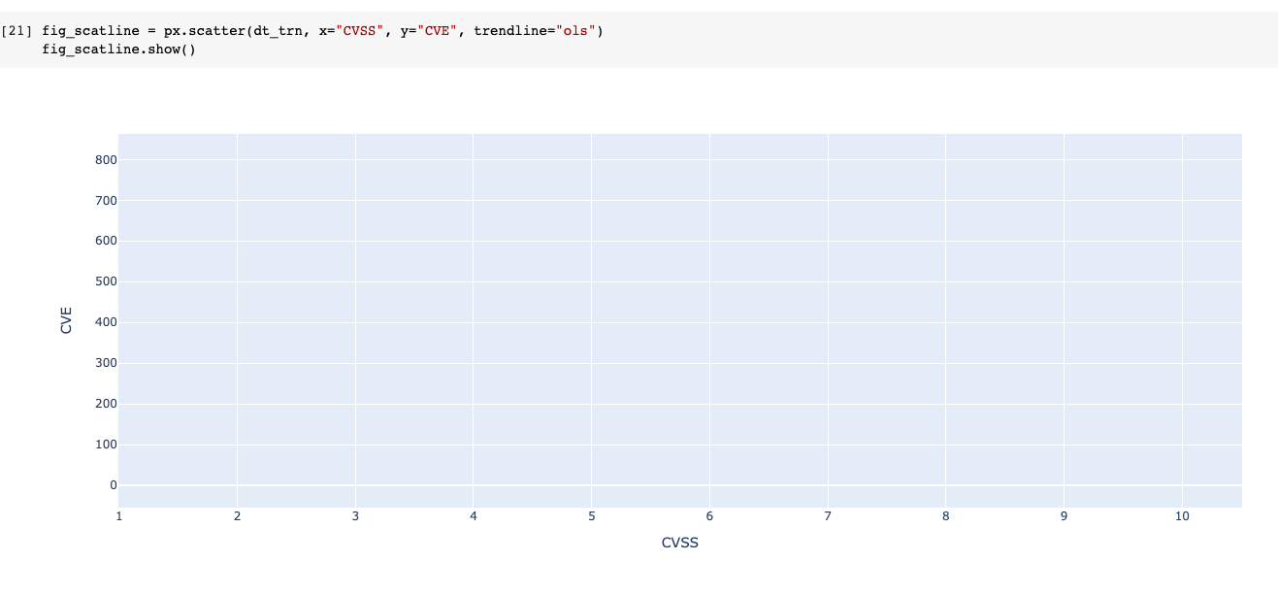
Data Visualization

Slide 9
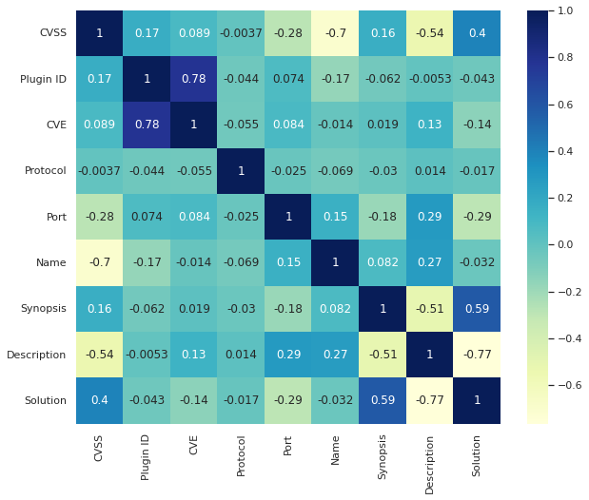

Slide 10
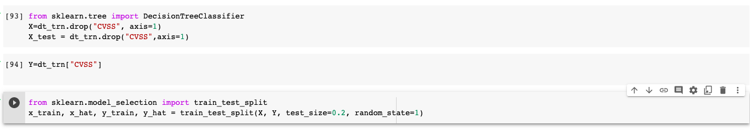
Handling data

Slide 11
Models
Random Forest Regression
Ridge Regression
Lasso Regression

Slide 12
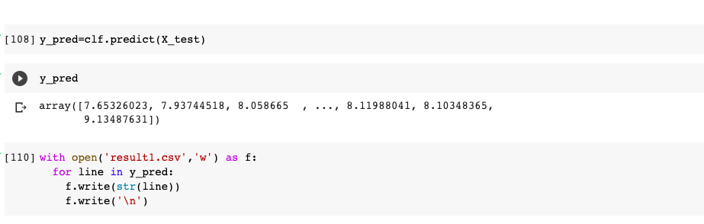
Ridge Regression
Ridge Regression is beneficial in case of working with higher number of predictive variables.
It can be used where multicollinearity can be seen in the dataset.

Slide 13
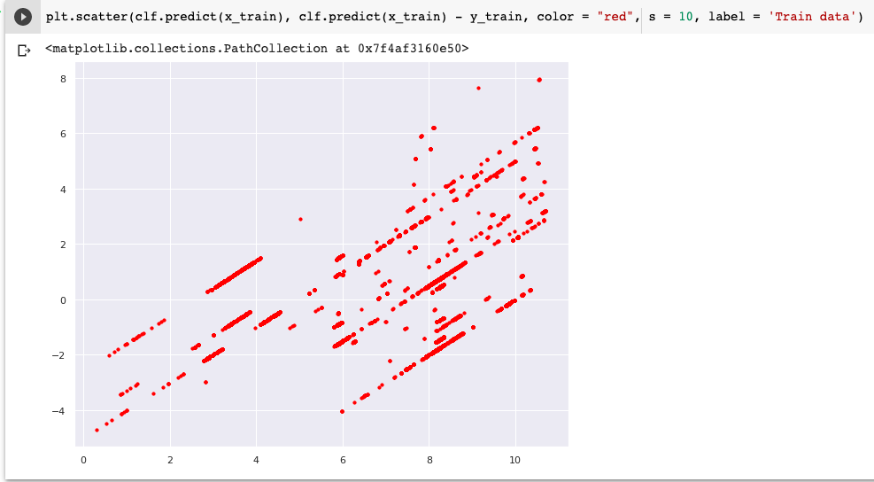
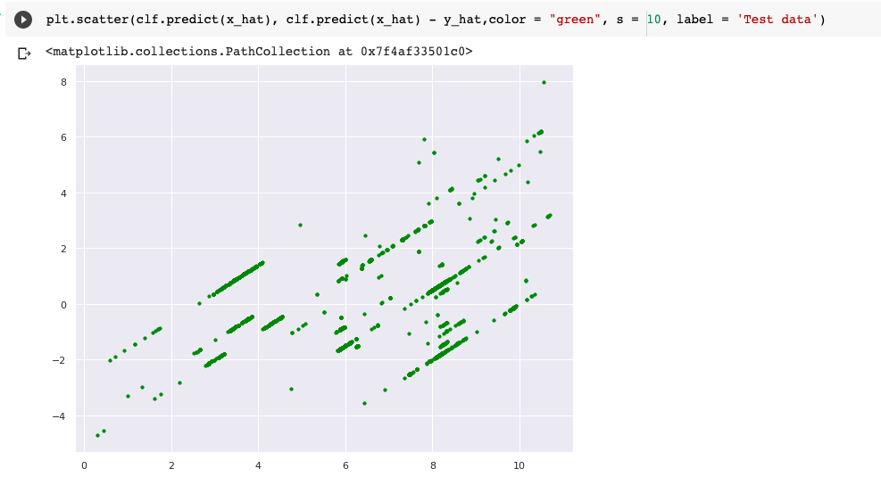

Slide 14
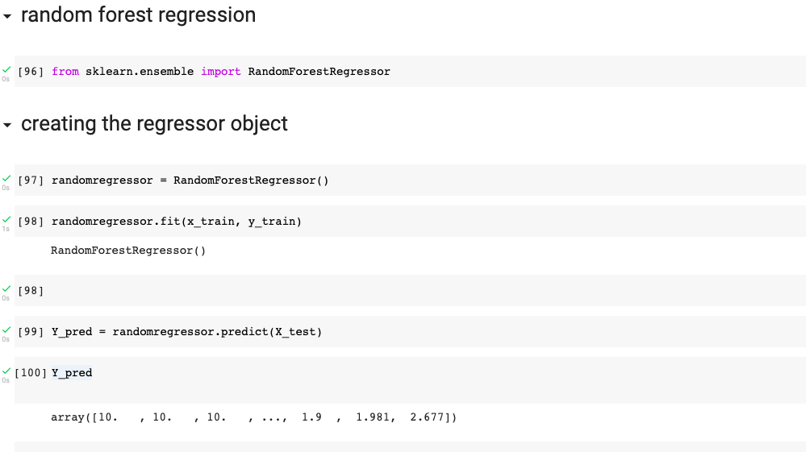
Random Forest Regression
The Accuracy is increased as the number of decision trees increased .
It can able to. Prevent the overfitting problem
The main advantage of using this algorithm is it takes very less training time and give the accuracy high.

Slide 15
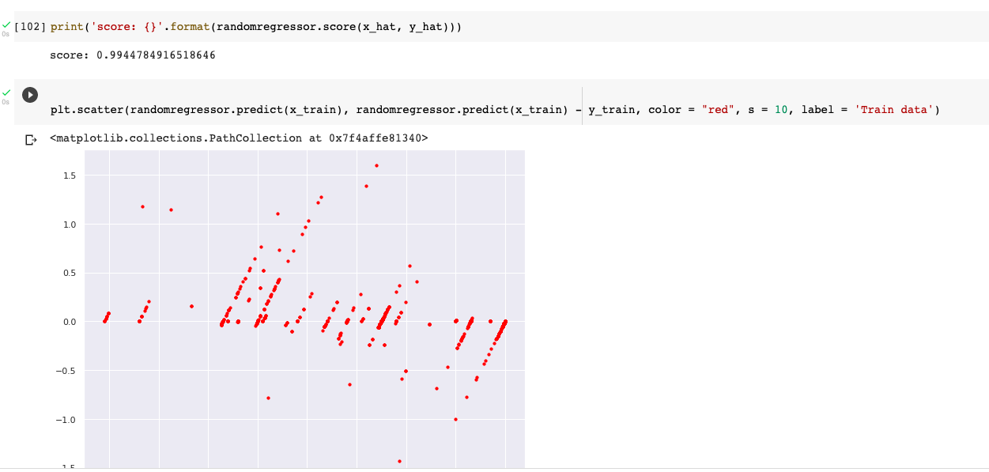

Slide 16
Lasso Regression
In this it can be used for getting accurate results from time to time by performing regularization techniques.
In uses a method called shrinkage.
It is used when multi collinearity can be seen in the data set. In the “lasso Regression”, the L1 regularization technique can be seen.
Over fitting of the data can be prevented using Lasso Regression.

Slide 17
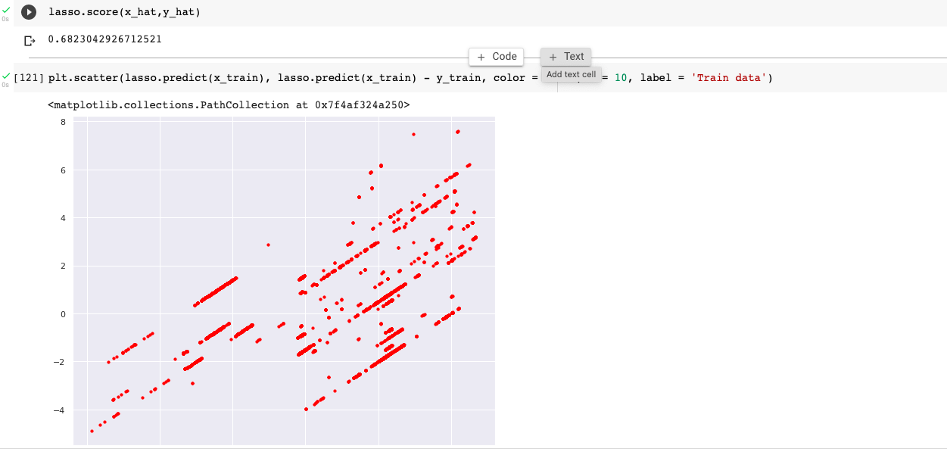

Slide 18
THANK YOU

